Slide 1
Your Customers Know More
About AI Than You Do
Building an AI-Powered Framework to Capture, Analyze,
and Act on Customer Feedback at Scale
Women Who Code • June 2026
Notes:
Key points:
We have an industry-wide challenge connecting customer feedback to action, and this gap is even wider for AI products
Then I’m going to talk about some useful tools and automation we can use to close that gap.

Slide 2
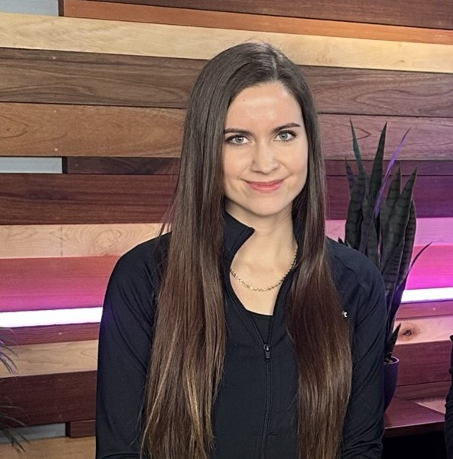
Marilee Turscak
Senior Product Manager • Microsoft
Identity & Network Access — Customer Acceleration Team

Slide 3
Raise your hand if...
You are using AI to analyze
customer feedback today.

Slide 4
Now keep your hand up if...
Your most recently shipped feature was directly informed by
something a customer actually said.
Notes:
- 28% of feedback experts already use AI for collecting and analyzing customer feedback — HubSpot (https://blog.hubspot.com/service/ai-customer-feedback-analysis) - 81% of CX leaders say AI-powered feedback analytics is a top priority, but only 7% have fully mature automation — Zonka Feedback (https://www.zonkafeedback.com/blog/ai-transforming-customer-feedback-analysis)

Slide 5
Why Feedback Doesn’t Become Action
Teams aren’t ignoring customers. It’s just complicated.
ALL PRODUCTS
AI PRODUCTS
📨
Scattered feedback
🎲
Non-deterministic
📊
Too much volume
especially for AI
🌍
Environment-dependent
⚖️
Hard to prioritize
🧪
Can’t test at scale
🔄
Difficult to action
Notes:
Deterministic: Username + password (works every time
Non0deterministic: Tell me which discount I should give this customer based on their purchase history

Slide 6
Why It’s Even Harder to Build AI Products Customers Value
23%
of consumers trust companies
to use AI responsibly
Thales Digital Trust Index 2026
96%
of developers don't trust AI
output — yet 52% ship it unverified
Sonar State of Code 2026
0%
of engineering leaders are
"very confident" AI code
behaves correctly in production
Stack Overflow 2025
Your customers are living with AI's limitations every day.
They're forming strong opinions your product team may not be hearing.
They are finding issues in production that test environments can't identify.
Your customers know exactly where AI breaks. They're the experts you're not listening to.

Slide 7
The Problem: We Collect Feedback but Don't Listen
93%
of customer feedback data
is never analyzed
Gartner 2025
95%
of companies collect feedback
but only 10% act on it
Bain & Company 2024
16%
of customers believe their
feedback drives actual change
Gartner 2026
As product teams, it’s our mission to fix this and build customer confidence.
The gap between collecting and acting on feedback is where products fail.
Customers have essentially given up expecting to be heard.
This is the trust gap we must close, especially for AI products.

Slide 8
The Cost of Not Listening
95%
of GenAI projects deliver
zero return — often lacking
meaningful feedback loops
MIT AI Report 2025
$3.7T
lost annually due to
poor customer experience
Qualtrics XM Institute 2024
41%
faster revenue growth for
customer-obsessed companies
Forrester 2025
Most AI products fail because they skip the feedback loop.
The cost is measured in trillions. But the companies that listen grow 41% faster.
Customers are your best friends in this process.

Slide 9
The Dual Challenge of Customer Feedback
Challenge 1: Scale
• Feedback comes from dozens of channels
• Meetings, supports tickets, surveys, Slack, Teams
• 73% of PMs say manual analysis
creates significant delays
• You can't read every transcript
Challenge 2: Signal
• Not all feedback is equally important
• Loudest voices ≠ most impactful issues
• Must separate trends from one-offs
• Eliminate recency bias
• Translation gap: feedback → action
You need to capture everything AND identify what matters most → AI solves both.

Slide 10
Putting It Into Practice: AI Skills for Feedback Analysis
Here's what this looks like in practice — two AI skills I built to automate this process.
Skill 1: Weekly Feedback Analyzer Skill
Skill 2: Cumulative Feedback Report Skill
What it does:
• Runs weekly as an agentic AI skill
• Ingests all new customer feedback files
• Extracts trends, sentiment shifts, blockers
• Generates a pulse report with recommendations
How it works:
• Structured markdown template: Key Takeaways, Feature Requests, Pain Points, Quotes, Sentiment, Follow-ups
• Compares with previous week's report and provides status update
What it does:
• Synthesizes ALL feedback across the preview
• One strategic document from months of data
What it produces:
• Executive summary
• Top trends ranked by frequency + trajectory
• Feature requests ranked by priority/number of mentions
• Bugs with severity and customer impact
• Pain points with cross-customer validation
• Per-customer sentiment over time
What took 4+ hours of manual analysis now runs in minutes — every single week, without fail.

Slide 11
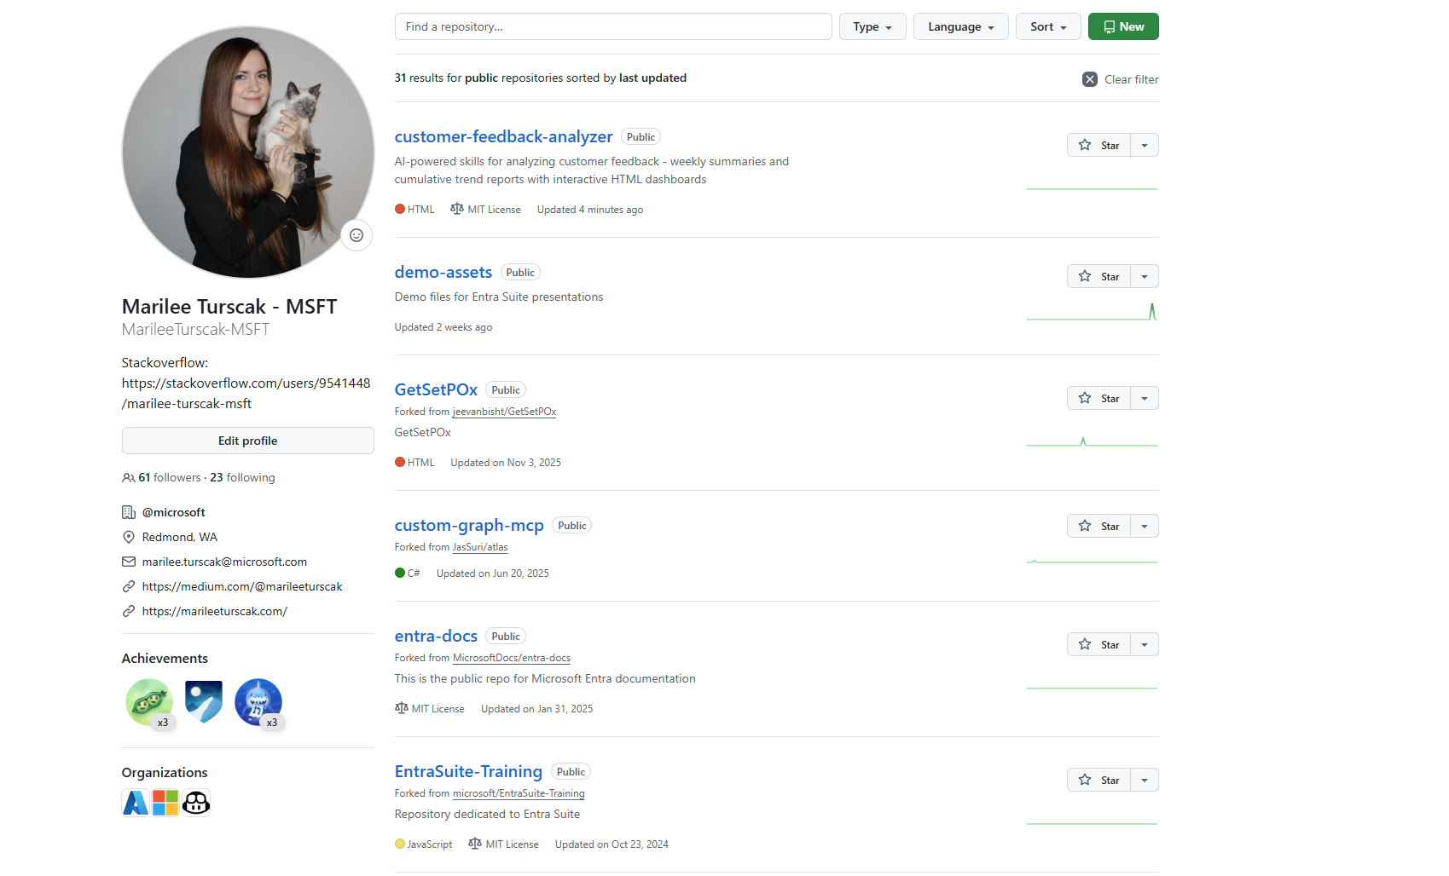
Github: Customer Feedback Analyzer
Aka.ms/feedbackanalyzer

Slide 12
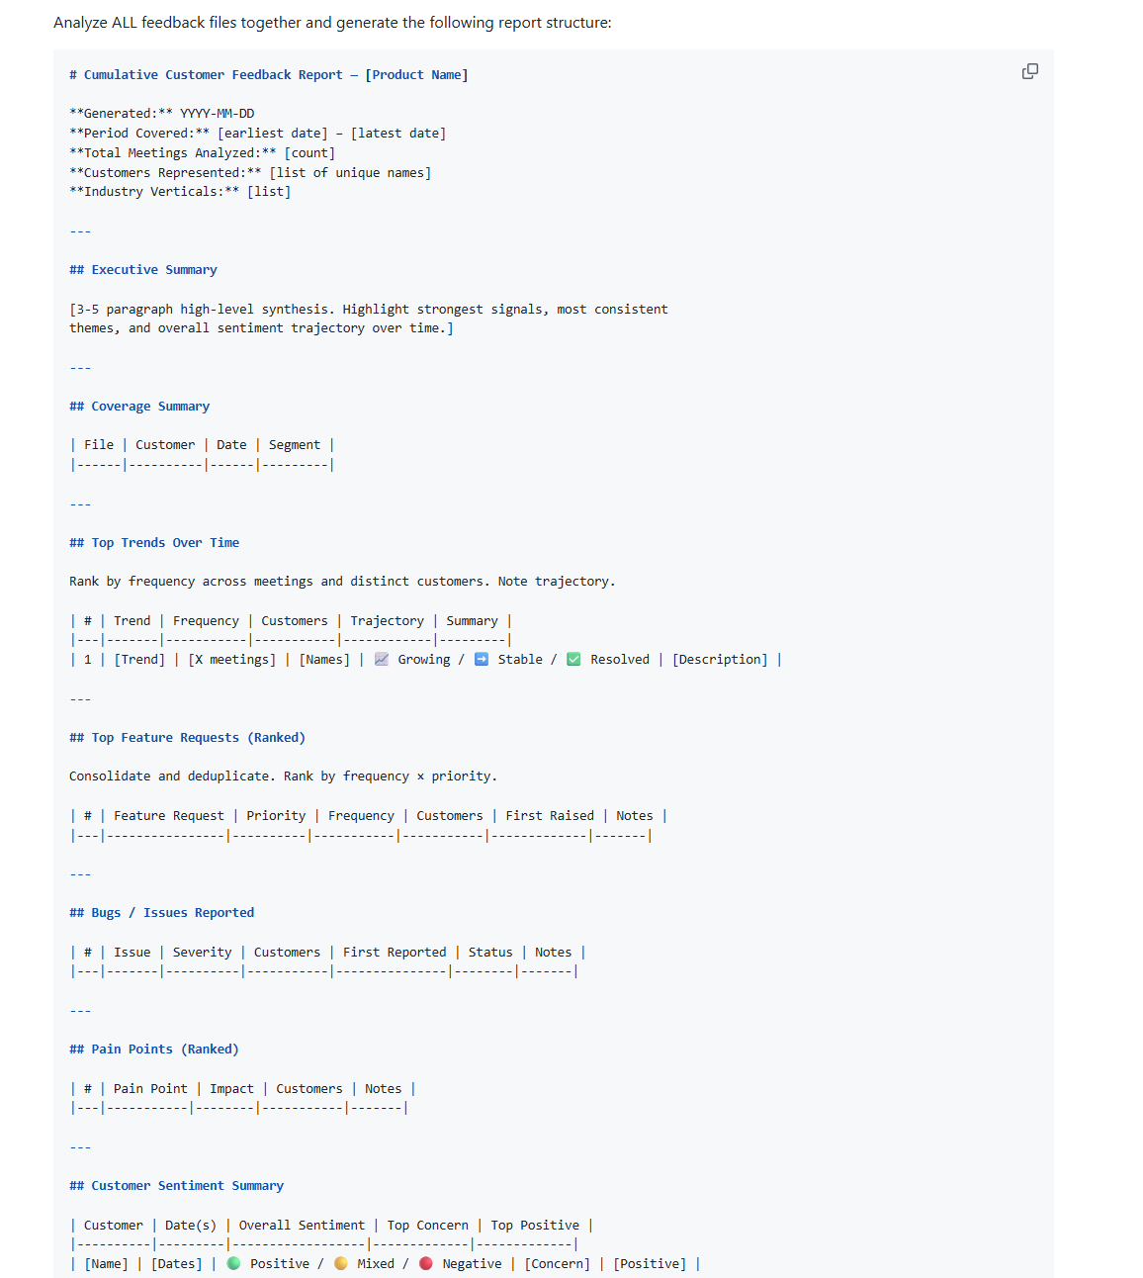
Github: Customer Feedback Analyzer
Markdown instructions:
Example prompt to create the skill:
Build me a skill that reads all my customer feedback notes from meeting transcripts, tickets, Teams conversations, and existing notes in my customer feedback folder and generates a report showing top trends, feature requests ranked by priority, bugs by severity, sentiment with real quotes, weighted feedback based on top customers, and recommended actions. Run the skill through security review to ensure all data is protected. Include an HTML dashboard with charts.

Slide 13
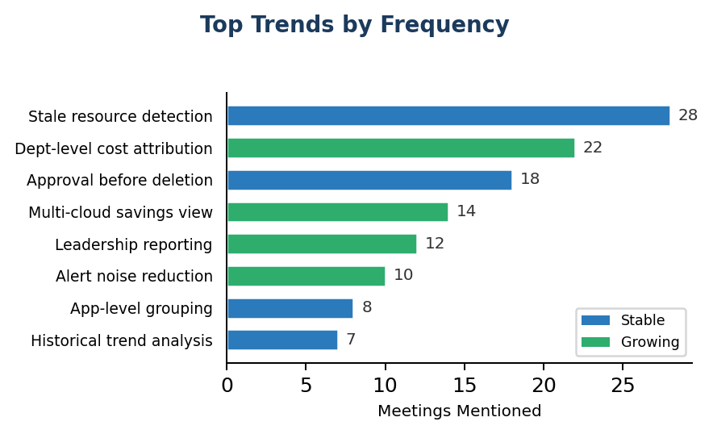
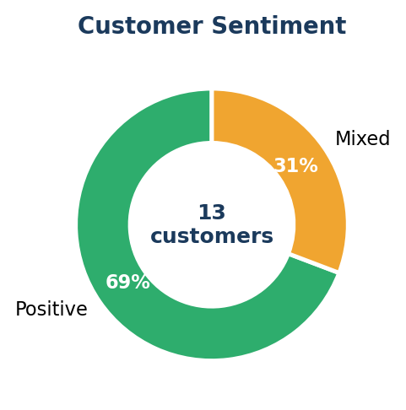
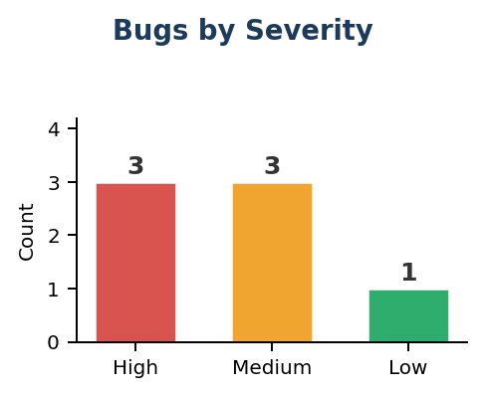
Cumulative Customer Feedback Report — AI Cost Analyzer
Jan 15 – May 25, 2026 • 32 Sessions • 18 Customers • 6 Industry Verticals
32
Total Sessions
18
Customers
11
Feature Requests
7
Open Bugs
69%
Sentiment: Positive
Top Feature Requests
• 🔴 Custom cost-center / dept attribution (22 meetings)
• 🔴 Approval workflow with impact preview (18 meetings)
• 🔴 Multi-cloud cost aggregation (14 meetings)
• 🔴 Automated leadership reports (12 meetings)
• 🟡 Configurable alert thresholds (10 meetings)
• 🟡 Application portfolio grouping (8 meetings)
Top Pain Points
• No department-level savings attribution — CFOs can't justify ROI
• Deletion without approval workflow — blocked in regulated industries
• Alert fatigue — 200+ daily alerts for sub-$1 resources
• Single-cloud limitation — manual Excel reconciliation workaround
• No executive reporting without product login
💬 "Finally, a tool that thinks like a FinOps engineer, not just a billing dashboard." — Cloud Architect, Litware Inc

Slide 14
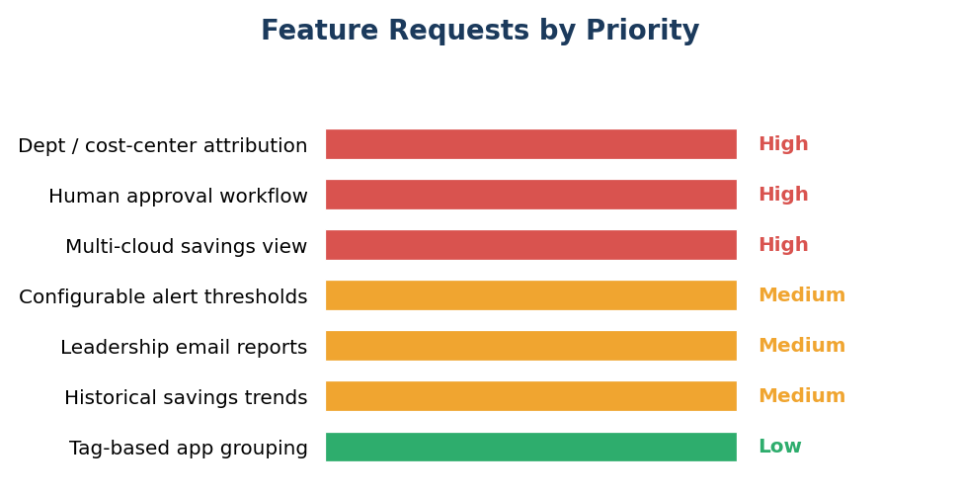
Weekly Customer Feedback Report — AI Cost Analyzer
Week of May 19–25, 2026 • 5 Customer Sessions • Generated by AI Feedback Skill
5
Customers This Week
7
Feature Requests
3
High Priority
6
Follow-up Actions
Positive
Avg. Sentiment
Key Takeaways
• Stale resource detection is the #1 value driver — 4/5 customers cited it as most valuable
• Contoso Financial: $42K/month saved within 3 weeks of onboarding
• Department-level cost attribution demanded by finance teams
• Trust in deletion recommendations still low — approval workflows needed
• Multi-cloud support emerging as critical gap for 60%+ multi-cloud enterprises
Customer Quotes
"We burned $1.2M last year on resources nobody was using. If this tool had existed, we'd have caught it in the first month."
— VP of Cloud Infrastructure, Contoso Financial
"I love the recommendations, but I can't click 'delete' on a production resource without my CAB seeing it first."
— Sr. Cloud Engineer, Fabrikam Healthcare
"The stale app detection alone justified the cost. We found 340 app registrations unused for over a year."
— Identity Team Lead, Woodgrove Bank

Slide 15
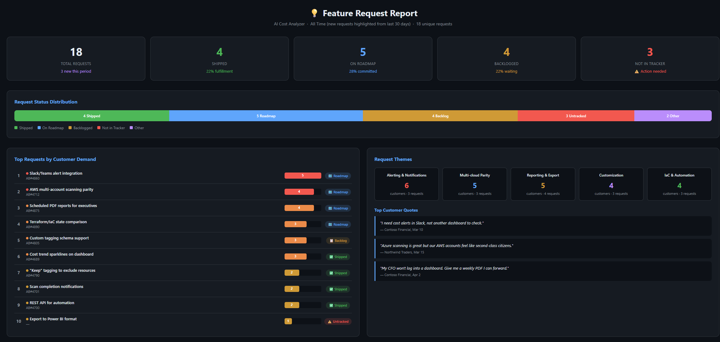

Slide 16
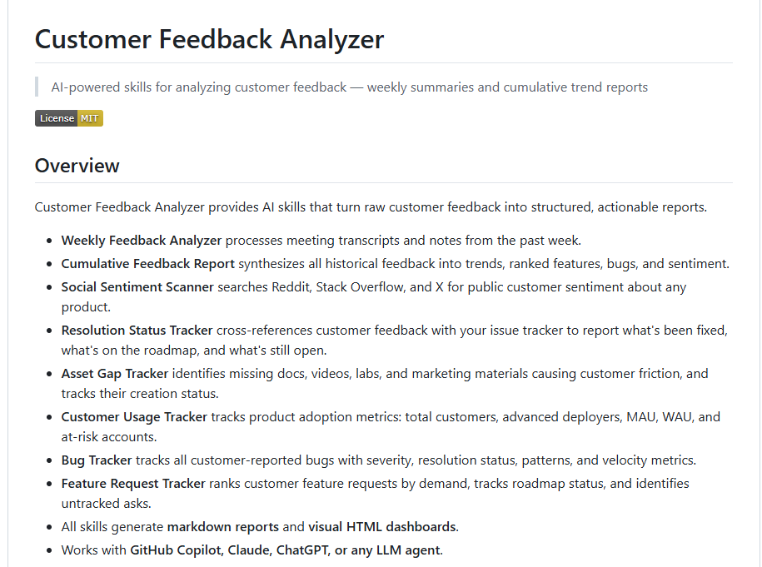
Github: Customer Feedback Analyzer
Aka.ms/feedbackanalyzer

Slide 17
The Framework I Give to the Agent
"Here's how I want you to analyze customer feedback every time."
🏢
📈
⭐
💡
Strategic Customer Feedback
Top Trends Across All Customers
Hero Scenarios
Top Feature Requests
Top 10 design partners. Their signals carry extra weight.
Recurring themes and patterns from the full population.
The 1-2 flagship features that define product success.
Ranked by demand. How many customers asked, and how often.
🐛
🔍
💬
Bugs
Friction / UX / Doc Gaps
Customer Quotes
Severity, frequency, resolution status. What's hurting customers right now.
Where customers get stuck, confused, or can't find answers.
Verbatim voice of the customer. The evidence behind every insight.

Slide 18
Aka.ms/feedbackanalyzer
Works With Any LLM
Plain-text markdown skills. No vendor lock-in. Use with any AI tool (local repo or web tool).
YOUR DATA
CHOOSE YOUR LLM
💬
Teams / Slack
📄
🟢
GPT-4 / GPT-4o
Meeting transcripts
OpenAI / Azure OpenAI
feedback-analyzer
📝
Markdown Notes
.prompt.md
🟣
Claude
Feedback files
Anthropic
Plain Markdown No SDK Required
🎫
Issue Trackers
🔵
Copilot
ADO / GitHub / Jira
GitHub Copilot Chat/ VS Code / CLI
📊
Telemetry
🟠
Gemini / Llama / etc.
Usage data & logs
Google / Meta / Open Source
🔓
🍴
🌐
No Vendor Lock-In
Fork & Customize
Open Source
Switch LLMs anytime — your skills still work
Clone the repo, edit the markdown, make it yours
MIT licensed on GitHub free for everyone

Slide 19
Key Takeaway
From manual notes and memory → to structured, AI-powered analysis at scale
❌ BEFORE
✅ AFTER
Scattered OneNote, Teams, memory
Single structured report across all customers
Feature requests lost or forgotten
Ranked by demand count with customer quotes
Same bug reported 3x before anyone notices the pattern
Patterns auto-detected across meetings
Weeks to connect dots across customers
Cumulative report generated same day
"I think 3 customers asked?"
"12 customers across 15 meetings requested this" (with citations)
🔗aka.ms/feedbackanalyzer
Open source · Works with any LLM · Clone it. Customize it. Close the feedback loop.

Slide 20
Your Customers Know More
About AI Than You Do.
Start listening. Start building the feedback loop.
Let AI do the heavy lifting.
Questions?
Notes:
Just to summarize: our customers really do know more about AI than we do, in the sense that they're using our products every day in real production environments. They see the gaps before we do.But the good news is we now have tools that help us address that feedback at scale and make sure nothing falls through the cracks.If you'd like to try the skills I showed today, you can fork the repo at aka.ms/feedbackanalyzer. And I'd love to see skills that you're building to tackle customer feedback in your own workflows — contributions are absolutely welcome.Any questions before we close?

